Slide 1





BUSINESS ANALYST PORTFOLIO PROJECT
Rahul Pharma
Government Tender Analytics Dashboard
Pratik Keni
Aspiring Business Analyst | Sales & Operations Background
Excel
MySQL
Power BI
Jira
Draw.io

Slide 2






COMPANY BACKGROUND
2
About Rahul Pharma
Rahul Pharma supplies medicines to government and private hospitals through tender contracts. The business depends on winning tenders, managing inventory, delivering on time, and collecting payments from hospitals.
Business Challenges
Low tender win rate
Delayed deliveries
Expired medicines
Outstanding payments
Supplier delays
Limited visibility into performance

Slide 3







STAKEHOLDER ANALYSIS
3
Who Uses This Dashboard
Stakeholder
Responsibility
Managing Director
Business decisions
Tender Team
Tender management
Finance Team
Payment tracking
Warehouse Team
Inventory management
Procurement Team
Supplier management
Logistics Team
Delivery management
Compliance Team
Audit & compliance monitoring
Source: Business Requirements Document (BRD)

Slide 4
BUSINESS PROBLEMS
4
Problems and Their Business Impact
Business data was spread across multiple Excel files, with no single view of performance. This made decision-making slow and difficult for management.
Business Problem
Business Impact
Tender rejection
Revenue loss
Delivery delays
Customer dissatisfaction
Medicine expiry
Inventory loss
Pending payments
Cash flow issues
Supplier issues
Operational risk
Compliance issues
Increased business risk
Source: Business Requirements Document (BRD)

Slide 5




BUSINESS OBJECTIVES
5
Project Goals
Improve tender success rate
Monitor profitability
Track delayed deliveries
Reduce medicine expiry risk
Improve payment collection
Improve supplier performance

Slide 6

Business Analysis METHODOLOGY
6
My Business Analyst Approach
1
2
3
4
Requirement Gathering
BRD Preparation
FRD Creation
User Stories & Acceptance Criteria
5
6
7
8
Data Modeling (ER Diagram)
SQL Analysis
Dashboard Design
Business Recommendations
This tells interviewers how I think and work as a Business Analyst start to finish.

Slide 7


BUSINESS ANALYST DELIVERABLES
7
What I Created for This Project
Business Requirements Document (BRD)
Functional Requirements Document (FRD)
User Stories
Acceptance Criteria
ER Diagram (Data Model)
Data Dictionary
SQL Analysis
Power BI Dashboard
This full set of deliverables shows end-to-end BA work — from gathering requirements to building the final dashboard.

Slide 8
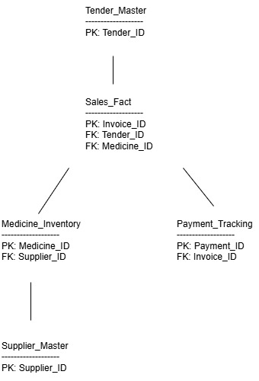
DATA MODEL
8
ER Diagram : Data Model Overview
Tender_Master
Sales_Fact
Payment_Tracking
PK: Payment_ID
FK: Invoice_ID
Supplier_Master
PK: Supplier_ID
Tender_Master holds tender details. Sales_Fact links each invoice to its tender and medicine, and feeds Medicine_Inventory and Payment_Tracking. Supplier_Master connects through Medicine_Inventory to track supplier-linked stock.

Slide 9
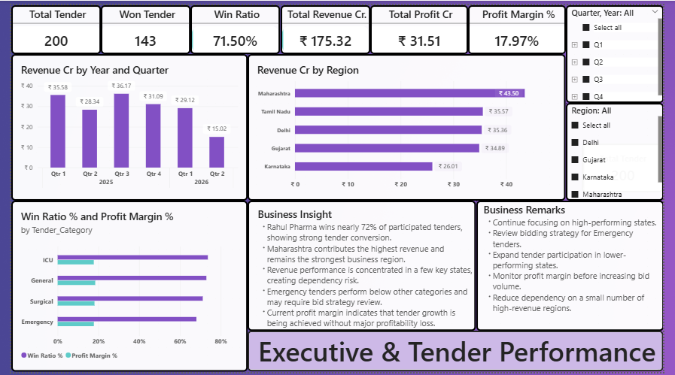
POWER BI DASHBOARD
9
Executive & Tender Performance

Slide 10
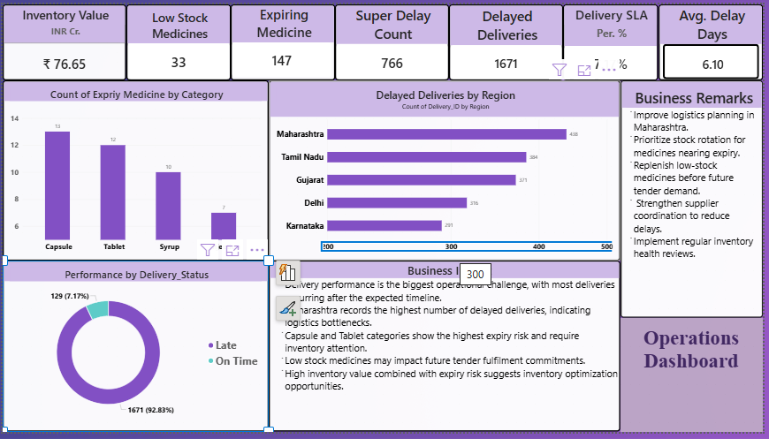
POWER BI DASHBOARD — PAGE 2
10
Operation Dashboard
1,671 delayed deliveries (92.8%) — Maharashtra has the highest delays, Karnataka the lowest
Capsule and Tablet medicines carry the highest expiry risk — inventory optimization is needed
Recommend monitoring delivery performance quarterly to catch delays early

Slide 11
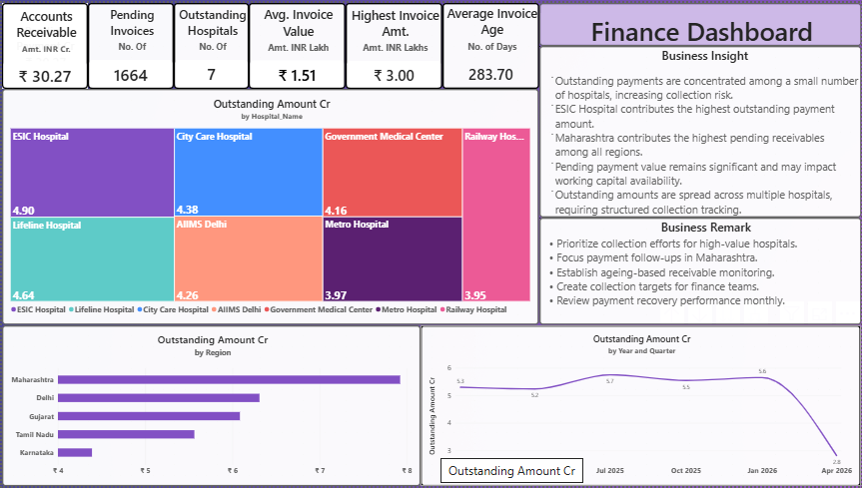
POWER BI DASHBOARD — PAGE 3
11
Finance Dashboard
₹30.27 Cr in outstanding receivables; ESIC Hospital has the highest outstanding amount
Average receivable age is 281 days — collection risk is increasing
High receivable age raises working capital risk — prioritize collection from top hospitals

Slide 12
Business Findings
12
Top 5 Business Finding
Maharashtra contributes highest revenue but also highest delivery delays.
Emergency tenders have lower performance than other categories.
Capsule and Tablet medicines show highest expiry risk.
ESIC Hospital has highest outstanding payments.
Average payment age exceeds 280 days, creating collection risk..

Slide 13

SQL ANALYSIS
12
Turning Raw Data into Business Insight
Tender Win Ratio
Revenue by State
SELECT tender_status,
COUNT(*) AS total_tenders
FROM tender_master
GROUP BY tender_status;
SELECT tm.Region,
SUM(sf.Sales_Amount)/1000 AS Revenue_K
FROM tender_master tm
JOIN sales_fact sf ON sf.Tender_ID=tm.Tender_ID
GROUP BY tm.Region;
143 of 200 tenders won — overall win ratio of 71.5%.
Maharashtra generates the highest revenue; Karnataka the lowest.
Average Delivery Delay by State
Outstanding Payments
SELECT tm.Region,
ROUND(AVG(dt.Delay_Days),2) AS Avg_Delay_Days
FROM delivery_tracking dt
INNER JOIN tender_master tm
ON dt.Tender_ID = tm.Tender_ID
GROUP BY tm.Region
ORDER BY Avg_Delay_Days DESC;
SELECT Hospital_Name,
SUM(Due_Amount) AS Pending_Amt
FROM payment_tracking
WHERE Payment_Status='Pending'
GROUP BY Hospital_Name
ORDER BY Pending_Amt DESC;
Average delivery delay is approximately 6 days.
Maharashtra records the highest delivery delays among all states.
ESIC Hospital carries the largest pending payment balance.

Slide 14


RECOMMENDATIONS
13
Key Recommendations
Tender
Operations
Finance
Review Emergency tender performance.
Study successful bidding patterns.
Increase participation in high-win regions.
Track supplier performance monthly.
Reduce delivery delays in Maharashtra.
Monitor expiry risk using inventory alerts.
Create ageing-based collection reports.
Prioritize high-value pending invoices.
Review payment recovery monthly.

Slide 15


PROJECT IMPACT
14
Before vs After the Dashboard
Before Dashboard
After Dashboard
Data stored in multiple Excel files
Manual reporting
Delayed decision-making
No centralized monitoring
Single source of truth
Faster reporting
Better visibility of tender performance
Better inventory & payment monitoring
This directly matches the BRD objective: a centralized reporting solution for tender, inventory, supplier, logistics, payment, and compliance activities.

Slide 16





BUSINESS IMPACT
15
Expected Benefits
Better tender decisions
Faster payment collection
Reduced stock shortages
Lower expiry losses
Improved profitability

Slide 17
BUSINESS ANALYST LEARNINGS
5
Tools and documentation
Understood business problems and converted them into reporting requirements.
Prepared BRD and FRD documents based on stakeholder needs.
Created user stories and acceptance criteria.
Designed an ER Diagram and data model.
Used SQL to answer business questions.
Built Power BI dashboards for management reporting.
Generated insights and recommendations to support decision making.
Improved understanding of Business Analysis, SQL, and Power BI.

Slide 18






PROJECT LEARNINGS
16
Skills Applied
Business Analysis
Requirement Gathering
SQL
Data Cleaning
Power BI
Dashboard Design
Business Insights
Pratik Keni
Aspiring Business Analyst | Sales & Operations Background | Mumbai
Thank You

